Slide 1

Bike Sharing Demand Analysis using Excel
(Dashboard Creation and Insights)
DR. POOJA KUMARI
(Course: Data science with AI)
2025-2026

Slide 2
Dataset Overview
Hourly bike rental data analysed
Key columns: Hour, Rentals, Temperature, Humidity, Season, Weather
Includes Weekend/Weekday classification and User Type info

Slide 3

Data cleaning
All three Excel files were uploaded and merged to eliminate all the duplicate columns.
After merging total 20 columns were created by adding weekend/weekday, weather label, weekend rentals and weekday rentals.
weekend/weekday: using if statement
Notes:
\j

Slide 4
Continue…..
Weather label: By supposing code and weather description respectively(1,2,3 and 4/ clear, mist, light rain, heavy rain.)
Filling missing data by just select two column we want to fix and then clink on HOME menu and click on find and select option then go to special and blanks in the new menu and than click ok now only blank cells are selected. Now go to the formula bar and enter = then select 2 columns from the data and select J AND K in our data then press ctrl + enter.

Slide 5
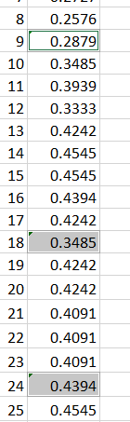
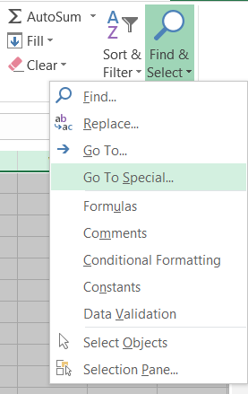
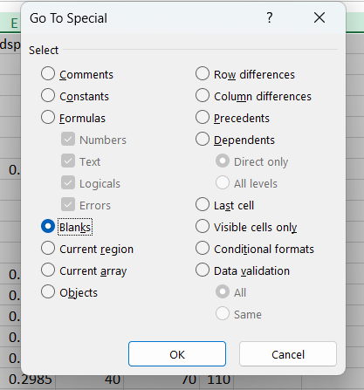
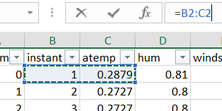
Filling missing values

Slide 6
Creating Pivot Chart
Click inside your data table
Go to INSERT and then to PivotTable
In the pop-up:
Select your data range
Drag DayType to Columns Choose "Existing Worksheet“
(As per your requirement for the table)

Slide 7
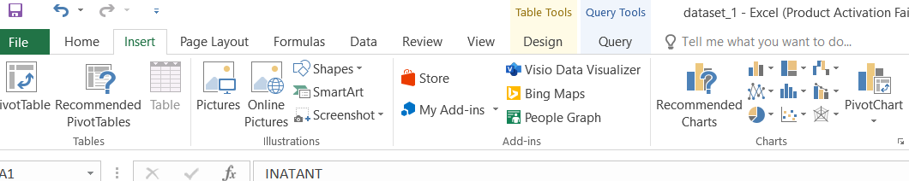
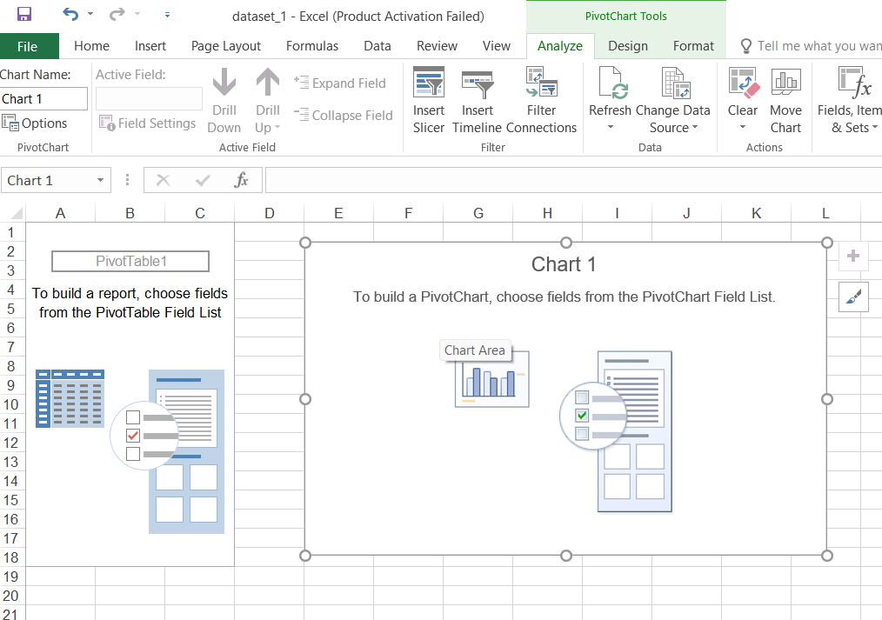
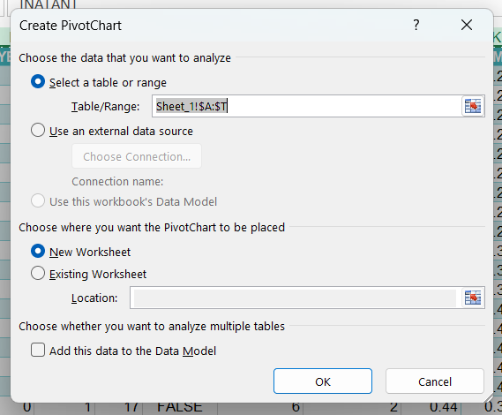
Creating pivot chart

Slide 8
Continue…..
Click OK
Use the PivotTable Field List:
Drag Hour to Rows
Drag Rentals to Values
(as needed for every pivot table)

Slide 9
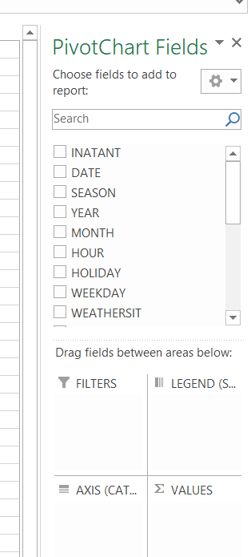
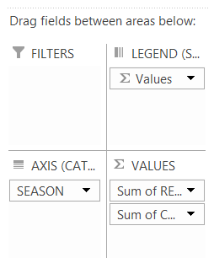
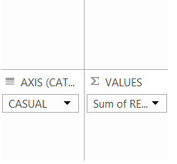
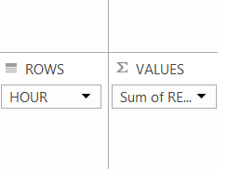
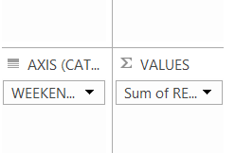
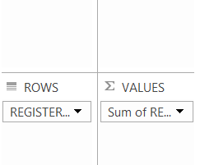
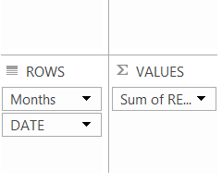

Slide 10
Continue…..
Pivot_chart.1:- Hours v/s Sum of rentals
Pivot_chart. 2:- Weekend/weekday v/s sum of rentals
Pivot_chart. 3:- Casual v/s sum of rentals
Pivot_chart. 4:- Registered v/s sum of rentals
Pivot_chart. 5:- Sum of casual v/s sum of registered
Pivot_chart. 6:- Sum of rentals by month and date

Slide 11
Creating Dashboard
Choose a relatable yet decent background for the dashboard.
Hide gridlines (View → Uncheck Gridlines)
Use shapes or titles for sections (Insert → Text Box)
Keep visuals aligned and easy to read
Insert multiple PivotTables (e.g., for Hourly Rentals, User Type, Day Type)

Slide 12
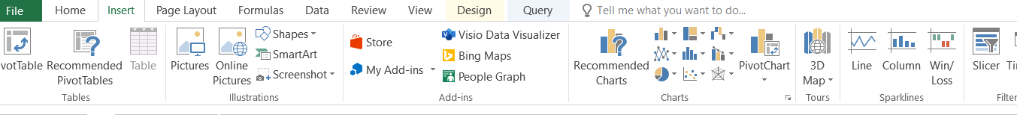
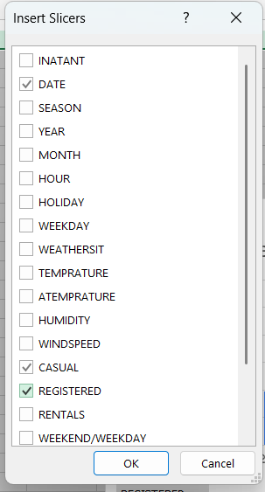
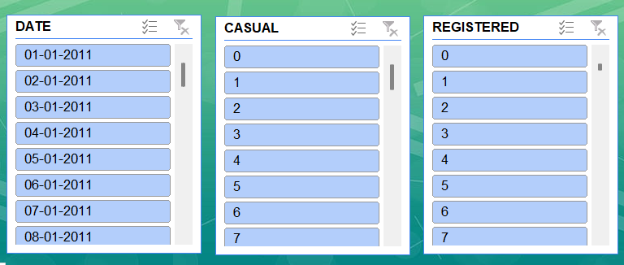

Slide 13
Timeline
Continue…..
Place each PivotTable in different corners of the same sheet (e.g., top-left, bottom-right)
Insert Slicers
Add slicers for filters like Season, Daytype or weather
Position them at the top or side of the sheet
Link slicers to all relevant PivotTables (left click-report connections-mark all the charts-OK)

Slide 14
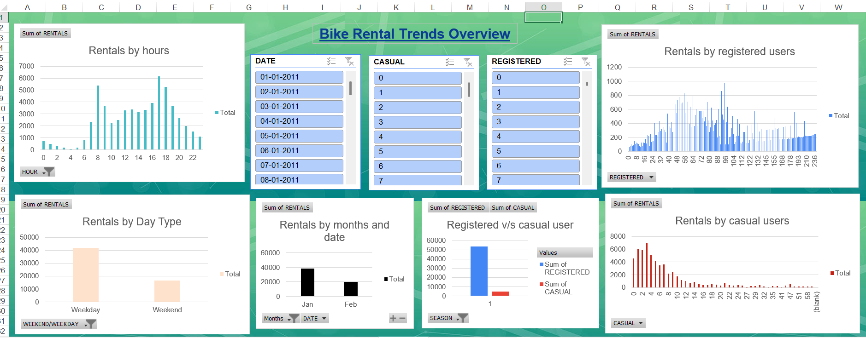
Pivot_chart.1
Pivot_chart.4
Pivot_chart.2
Pivot_chart.3
Pivot_chart. 6
Pivot_chart.5

Slide 15
Final Recommendations
Optimize Peak-Hour AvailabilityAnalyze rental spikes during 8–10 AM and 5–7 PM. Increase bike stock and enable dynamic pricing to maximize revenue.
Weather-Aware StrategyRentals dip significantly during rainy or misty conditions. Offer rain protection gear or send in-app alerts to inform users in advance.
Weekend Engagement CampaignsCasual rentals rise on weekends, especially among non-commuters. Launch weekend loyalty offers, discounts, or group ride promotions.

Slide 16
Continue…..
4. Seasonal Marketing Boost focus marketing during Spring and Fall, the seasons with the highest demand. Use these windows to acquire and retain users.
5. Infrastructure Expansion High rentals during office commute hours suggest growth potential. Set up bike stations near business hubs and metro stations for seamless access.

Slide 17
Continue…..
Business Impact Based on Our Recommendations
Increased Revenue through dynamic pricing and optimized bike availability
Better User Retention with personalized weather alerts and weekend offers
Efficient Resource Planning via data-driven peak-hour and location analysis
Enhanced User Satisfaction by improving convenience and experience

Slide 18
THANK YOU

